Slide 1
Prover 9 Tutorial
Linrui Zhang

Slide 2
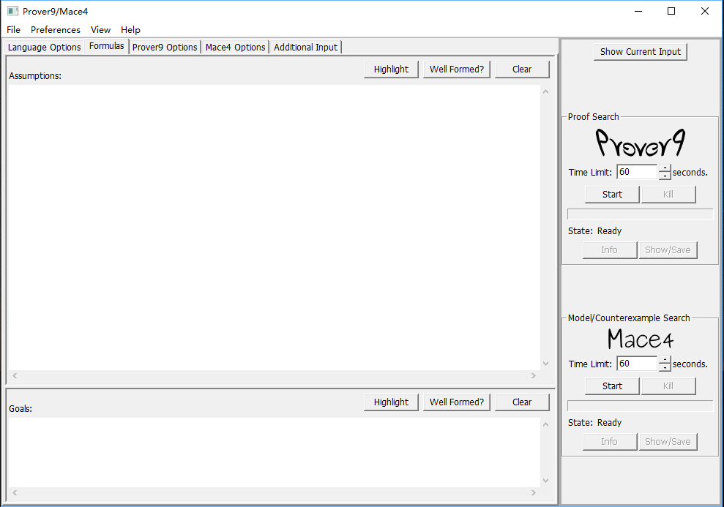
Download and Setup
https://www.cs.unm.edu/~mccune/prover9/download/
Windows
Linux
Mac OS
GUI
Command line

Slide 3
Notations
 | FOL | Prover9
and | ∧ | &
or | ∨ | |
Infer | ⇒ | ->
Existential | ∃ | exists
Universal | ∀ | All
negation | ¬ | -
End of sentence | Nothing | .

Slide 4
Example
Assumptions:
Wolves, foxes, birds, caterpillars, and snails are animals,
and there are some of each of them.
Also there are some grains, and grains are plants.
Every animal either likes to eat all plants or all animals much smaller than itself that like to eat some plants.
Caterpillars and snails are much smaller than birds, which are much smaller than foxes, which are in turn much smaller than wolves.
Wolves do not like to eat foxes or grains, while birds like to eat caterpillars but not snails.
Caterpillars and snails like to eat some plants.
Goal:
Prove there is an animal that likes to eat a grain-eating animal.
(where a grain eating animal is one that eats all grains)

Slide 5
Example continue
Wolves, foxes, birds, caterpillars, and snails are animals,
∀ x (Wolf(x) ⇒ animal(x))
∀ x (Fox(x) ⇒ animal(x))
∀ x (Bird(x) ⇒ animal(x))
∀ x (Caterpillar(x) ⇒ animal(x))
∀ x (Snail(x) ⇒ animal(x))
all x (Wolf(x) -> animal(x)).
all x (Fox(x) -> animal(x)).
all x (Bird(x) -> animal(x)).
all x (Caterpillar(x) -> animal(x)).
all x (Snail(x) -> animal(x)).

Slide 6
Example continue
and there are some of each of them.
∃ x Wolf(x)
∃ x Fox(x)
∃ x Bird(x)
∃ x Caterpillar(x)
∃ x Snail(x)
exists x Wolf(x).
exists x Fox(x).
exists x Bird(x).
exists x Caterpillar(x).
exists x Snail(x).

Slide 7
Example continue
Also there are some grains, and grains are plants
∃ x Grain(x)
∀ x (Grain(x) ⇒ plant(x))
all x (Grain(x) -> plant(x)).
exists x Grain(x).

Slide 8
Example continue
Every animal either likes to eat all plants or all animals much smaller than itself that like to eat some plants.
∀ x (animal(x) ⇒ (∀ y (plant(y) ⇒ eats(x,y))) ∨ (∀ z ( animal(z) ∧ Smaller(z,x) ∧ (∃ u (plant(u) ∧ eats(z,u))) ⇒ eats(x,z))))
all x (animal(x) -> (all y (plant(y)->eats(x,y))) | (all z ( animal(z) & Smaller(z,x) & (exists u (plant(u)&eats(z,u))) -> eats(x,z)))).

Slide 9
Example continue
Caterpillars and snails are much smaller than birds, which are much
smaller than foxes, which are in turn much smaller than wolves.
∀ x ∀ y (Caterpillar(x) ∧ Bird(y) ⇒ Smaller(x,y))
∀ x ∀ y (Snail(x) ∧ Bird(y) ⇒ Smaller(x,y))
∀ x ∀ y (Bird(x) ∧ Fox(y) ⇒ Smaller(x,y))
∀ x ∀ y (Fox(x) ∧ Wolf(y) ⇒ Smaller(x,y))
all x all y (Caterpillar(x) & Bird(y) -> Smaller(x,y)).
all x all y (Snail(x) & Bird(y) -> Smaller(x,y)).
all x all y (Bird(x) & Fox(y) -> Smaller(x,y)).
all x all y (Fox(x) & Wolf(y) -> Smaller(x,y)).

Slide 10
Example continue
Wolves do not like to eat foxes or grains, while birds like to eat caterpillars but not snails.
∀ x ∀ y (Wolf(x) ∧ Fox(y) ⇒ ¬eats(x,y))
∀ x ∀ y (Wolf(x) ∧ Grain(y) ⇒ ¬eats(x,y))
∀ x ∀ y (Bird(x) ∧ Caterpillar(y) ⇒ eats(x,y)
∀ x ∀ y (Bird(x) ∧ Snail(y) ⇒ ¬eats(x,y))
all x all y (Wolf(x) & Fox(y) -> -eats(x,y)).
all x all y (Wolf(x) & Grain(y) -> -eats(x,y)).
all x all y (Bird(x) & Caterpillar(y) -> eats(x,y)).
all x all y (Bird(x) & Snail(y) -> -eats(x,y)).

Slide 11
Example continue
Caterpillars and snails like to eat some plant
∀ x (Caterpillar(x) ⇒ (∃ y (plant(y) ∧ eats(x,y))))
∀ x (Snail(x) ⇒ (∃ y (plant(y) ∧ eats(x,y))))
all x (Caterpillar(x) -> (exists y (plant(y) & eats(x,y)))).
all x (Snail(x) -> (exists y (plant(y) & eats(x,y)))).

Slide 12
Example continue
Prove there is an animal that likes to eat a grain-eating animal.
∃ x ∃ y ( animal(x) ∧ animal(y) ∧ eats(x,y) ∧ (all z (Grain(z) ⇒ eats(y,z))) )
exists x exists y ( animal(x) & animal(y) & eats(x,y) & (all z (Grain(z) -> eats(y,z))) ).

Slide 13
Assumptions:
all x (Wolf(x) -> animal(x)).
all x (Fox(x) -> animal(x)).
all x (Bird(x) -> animal(x)).
all x (Caterpillar(x) -> animal(x)).
all x (Snail(x) -> animal(x)).
all x (Grain(x) -> plant(x)).
exists x Wolf(x).
exists x Fox(x).
exists x Bird(x).
exists x Caterpillar(x).
exists x Snail(x).
exists x Grain(x).
all x (animal(x) -> (all y (plant(y)->eats(x,y))) | (all z ( animal(z) & Smaller(z,x) & (exists u (plant(u)&eats(z,u))) -> eats(x,z)))).
all x all y (Caterpillar(x) & Bird(y) -> Smaller(x,y)).
all x all y (Snail(x) & Bird(y) -> Smaller(x,y)).
all x all y (Bird(x) & Fox(y) -> Smaller(x,y)).
all x all y (Fox(x) & Wolf(y) -> Smaller(x,y)).
all x all y (Bird(x) & Caterpillar(y) -> eats(x,y)).
all x (Caterpillar(x) -> (exists y (plant(y) & eats(x,y)))). all x (Snail(x) -> (exists y (plant(y) & eats(x,y)))).
all x all y (Wolf(x) & Fox(y) -> -eats(x,y)).
all x all y (Wolf(x) & Grain(y) -> -eats(x,y)). all x all y (Bird(x) & Snail(y) -> -eats(x,y)).

Slide 14
Goals:
exists x exists y ( animal(x) & animal(y) & eats(x,y) & (all z (Grain(z) -> eats(y,z))) ).

